Slide 1
Chapter 15 Computer Careers and Certification

Slide 2
Chapter 15 Objectives
Identify ways to stay current with changing technology after graduation
Describe career opportunities available in various segments of the computer industry
List the benefits of certification for employers, employees, and vendors
Discuss functions of jobs available in an IT department
Identify ways to prepare for certification
Distinguish between trade schools and colleges
List the general areas of IT certification
Differentiate among various computer-related majors for college students
Name some specific IT certifications in each certification area
Next

Slide 3
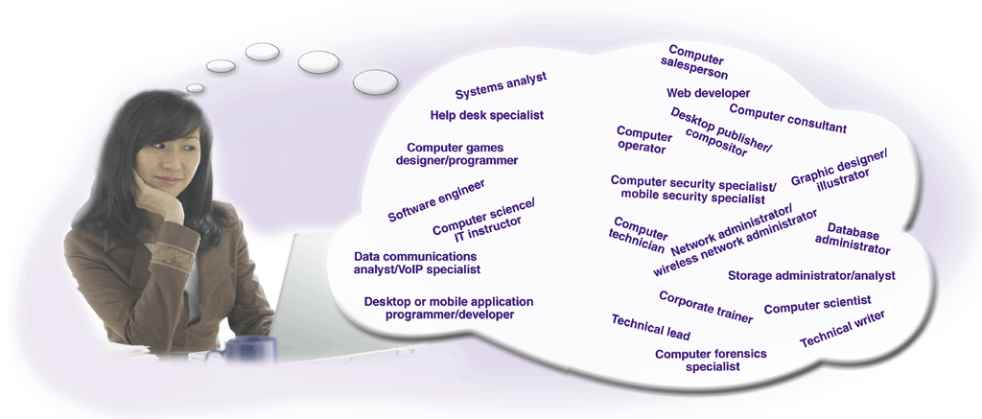
The Computer Industry
What is the expected demand for computer professionals?
Currently 11 million computer workers with expected increase of 2 to 3% annually
The number of students majoring in computer-related fields is declining
p. 776 - 777 Fig. 15-1
Next

Slide 4
Careers in the Computer Industry
What are the primary areas where job opportunities are found?
General business and government organizations
Computer equipment field
Computer software field
Computer service and repair field
Computer education and training field
Computer sales
IT consulting field
p. 778
Next

Slide 5

Careers in the Computer Industry
What is an IT department?
Department in business or government agency that employs people in computer-related jobs
Responsible for keeping all computer operations and networks operating smoothly
p. 778 - 779 Fig. 15-2
Next

Slide 6
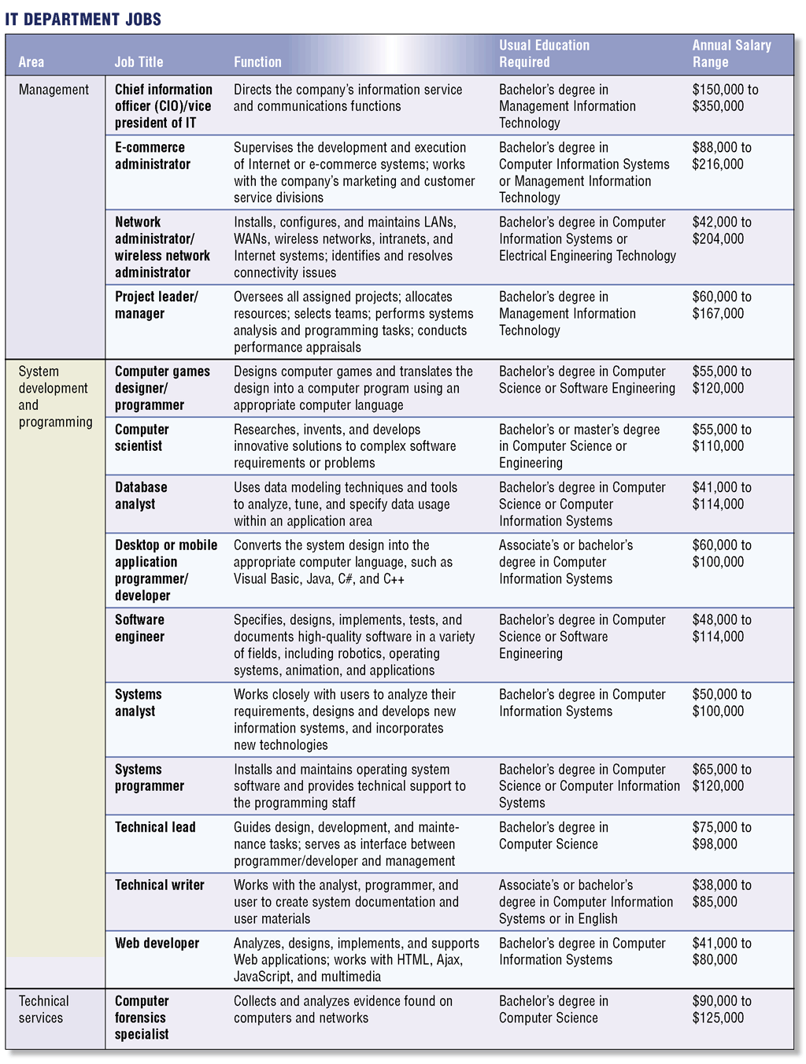
Careers in the Computer Industry
What jobs are available in an IT department?
Click to view Web Link, click Chapter 15, Click Web Link from left navigation, then click Computer Career Salaries below Chapter 15
p. 780 – 781 Fig. 15-3
Next

Slide 7
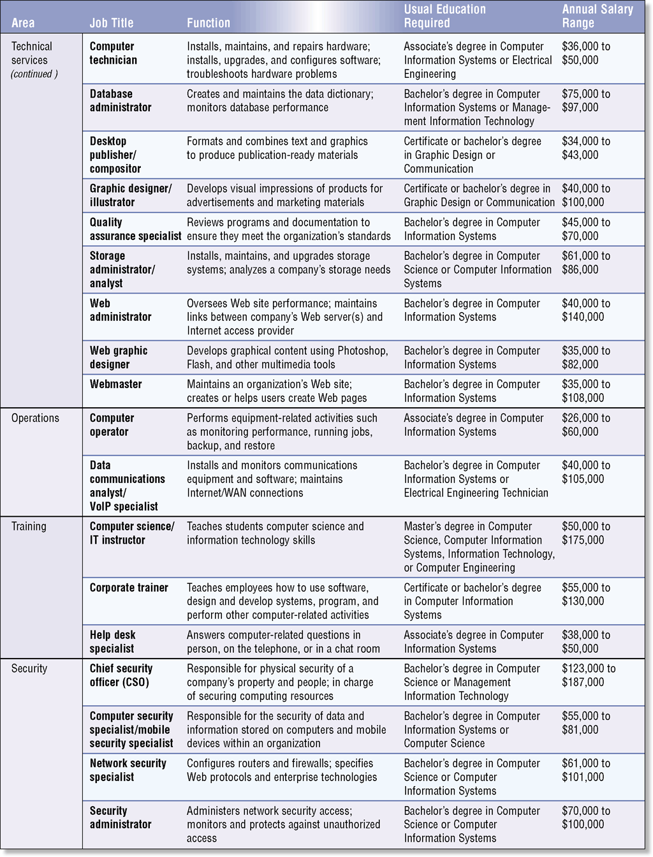
Careers in the Computer Industry
What jobs are available in an IT department?
p. 780 – 781 Fig. 15-3
Next

Slide 8

Careers in the Computer Industry
What is the computer equipment field?
Manufacturers and distributors of computers and computer-related hardware
Careers involve design, manufacture, and production of computer equipment
p. 782 Fig. 15-4
Next

Slide 9
Careers in the Computer Industry
What is the computer software field?
Companies that develop, manufacture, and support software
Project leader analyzes requirements, designs solutions, and oversees software development process
Programmer writes and tests computer programs
Software engineer designs and develops software
Computer scientist researches, invents, and develops solutions to complex software problems
p. 782 - 783
Next

Slide 10
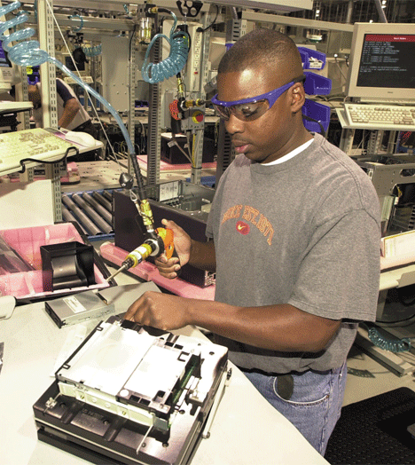
Careers in the Computer Industry
What is the computer service and repair field?
Provides preventative maintenance, component installation, and repair services
Computer technician—installs, maintains, and repairs hardware
p. 783 Fig. 15-5
Next

Slide 11

Careers in the Computer Industry
What are career opportunities in computer sales?
Computer salespeople need general understanding of computers and specific knowledge of the product they are selling
Click to view Web Link, click Chapter 15, Click Web Link from left navigation, then click Computer Salespeople below Chapter 15
p. 783 - 784 Fig. 15-6
Next

Slide 12

Careers in the Computer Industry
What are career opportunities in education and training?
Schools, colleges, universities, and private companies need educators and trainers
Corporate trainers teach employees how to use software, design and develop systems, and program
p. 784 Fig. 15-7
Next

Slide 13
Careers in the Computer Industry
What is an IT consultant?
Individual who draws upon expertise in specialized area of computers
Computer selection
System design
Communications
Hardware and software configuration
Network design and installation
Web development
Click to view Web Link, click Chapter 15, Click Web Link from left navigation, then click IT Consultant below Chapter 15
p. 784
Next

Slide 14
Preparing for a Career in the Computer Industry
What is a trade school?
Offers programs in programming, Web development, graphic design, hardware maintenance, networking, PC support, and security
Students can complete trade school programs in shorter time than college or university programs
Click to view Web Link, click Chapter 15, Click Web Link from left navigation, then click Trade Schools below Chapter 15
p. 785
Next

Slide 15
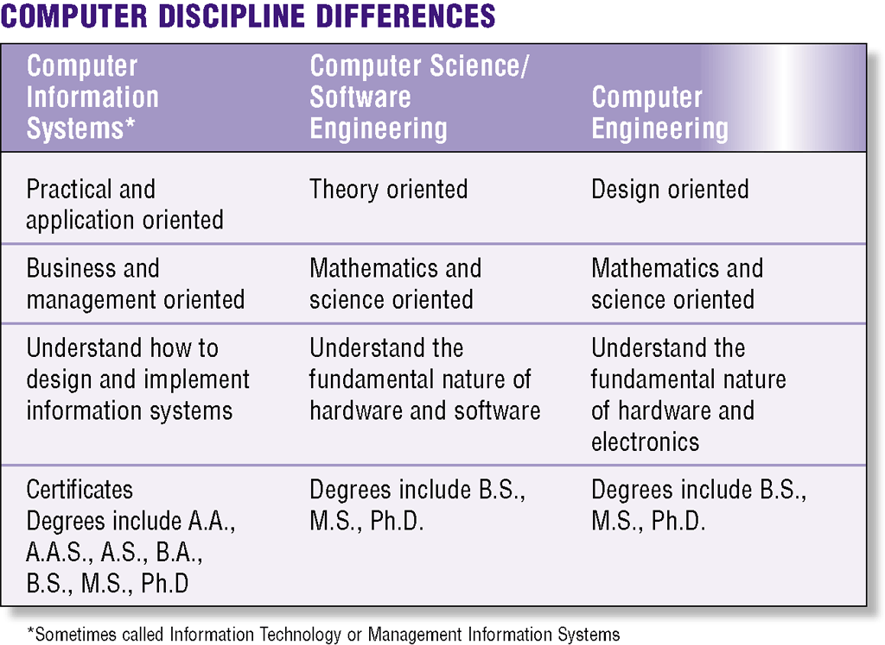
Preparing for a Career in the Computer Industry
What are the three broad disciplines in higher education that produce the majority of entry-level employees in the computer industry?
Click to view Web Link, click Chapter 15, Click Web Link from left navigation, then click Computer Information Systems below Chapter 15
p. 786 Fig. 15-8
Next

Slide 16
Preparing for a Career in the Computer Industry
What is computer information systems (CIS)?
Programs that emphasize technical knowledge and skills
Sometimes called management information systems (MIS) or management information technology
p. 786
Next

Slide 17
Preparing for a Career in the Computer Industry
What is computer science (CS)?
Programs that stress theoretical side of programming and operating systems
Also called software engineering
p. 786 - 787
Next

Slide 18
Preparing for a Career in the Computer Industry
What is computer engineering (CE)?
Teaches students how to design and develop the electrical components found in computers and peripheral devices
Required courses include application and systems programming, data and file structures, networks, and operating systems
p. 787
Next

Slide 19
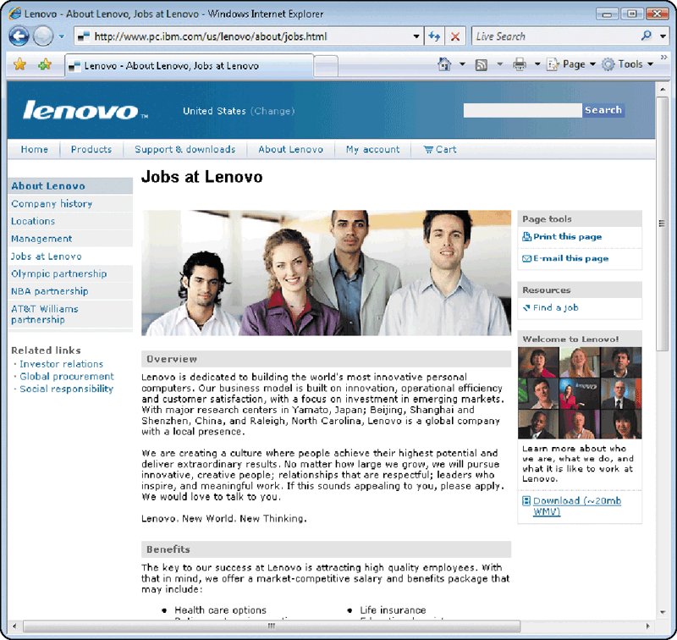
Preparing for a Career in the Computer Industry
How do companies advertise computer-related job openings?
Some Web sites specialized in helping people find jobs
Some allow job seekers to submit resumes online
p. 787 - 788 Fig. 15-9
Next

Slide 20
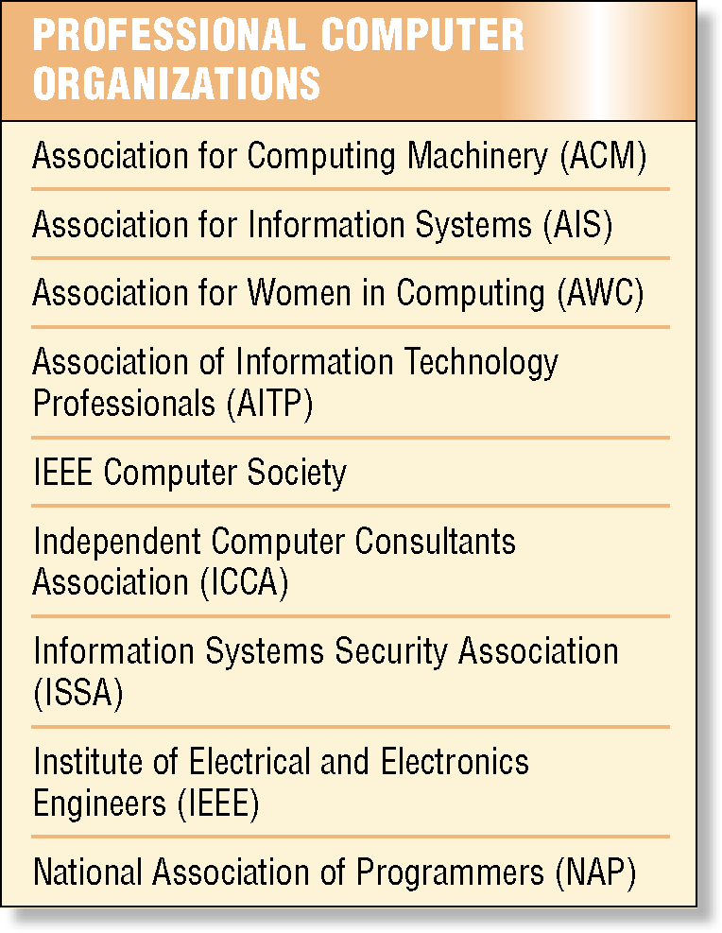
Preparing for a Career in the Computer Industry
What are some organizations for computer professionals?
Association for Computing Machinery (ACM)—science-oriented
Association of Information Technology Professionals (AITP)—programmers, systems analysts, and information processing managers
p. 789 Fig. 15-11
Next

Slide 21
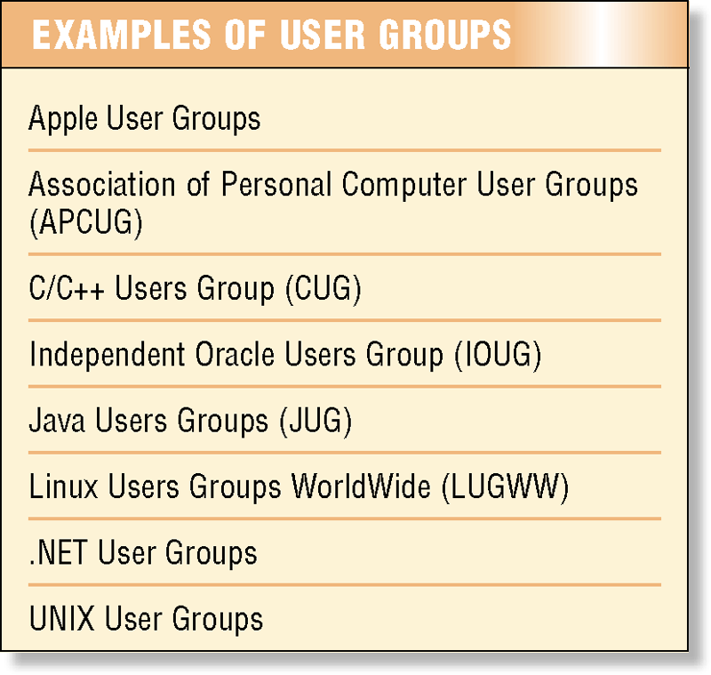
Preparing for a Career in the Computer Industry
What is a user group?
Collection of people with common computer equipment or software interests
p. 790 Fig. 15-12
Next

Slide 22

Preparing for a Career in the Computer Industry
What is professional growth and continuing education?
Events such as workshops, seminars, conferences, conventions, and trade shows
CES—trade show that brings together hundreds of vendors and more than 140,000 attendees
Training in form of books, video-based training, computer-based training (CBT), Web-based training (WBT), and instructor-led training
p. 790 Fig. 15-13
Next

Slide 23

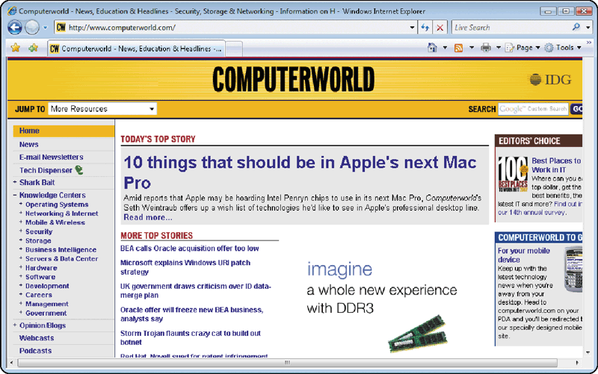
Preparing for a Career in the Computer Industry
How can you stay informed about the computer industry?
Computer industry publications
News, blogs, and technical Web sites
Click to view Web Link, click Chapter 15, Click Web Link from left navigation, then click Computer Publications below Chapter 15
p. 791 Figs. 15-14, 15-15
Next

Slide 24
Certification
What is certification?
Process of verifying
Technical knowledge in
a particular area
Proficiency is acknowledged
with certificate
p. 791
Next

Slide 25
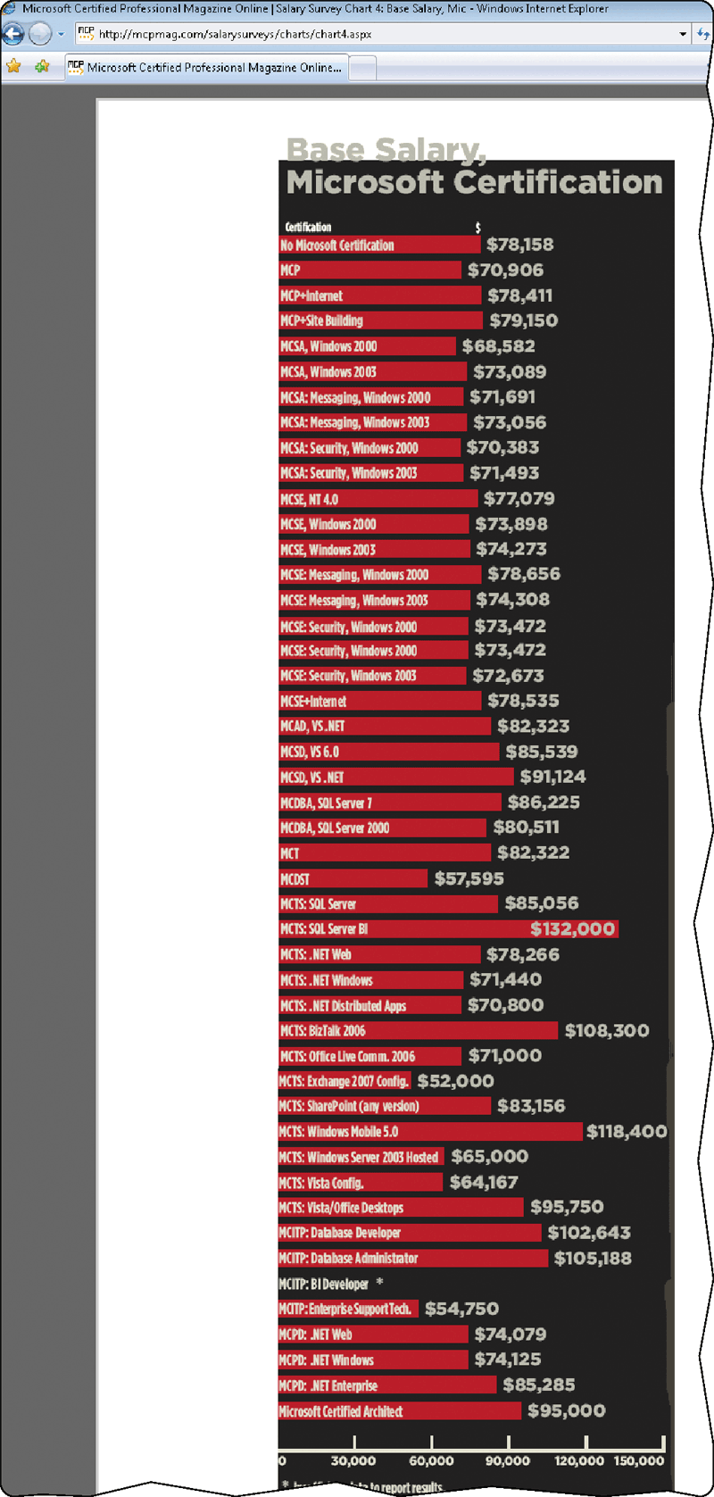
Certification
What are the benefits of certification?
Enhances employee’s career, provides better standing as industry professional, and higher salaries and bonuses
p. 792 Fig. 15-16
Next

Slide 26
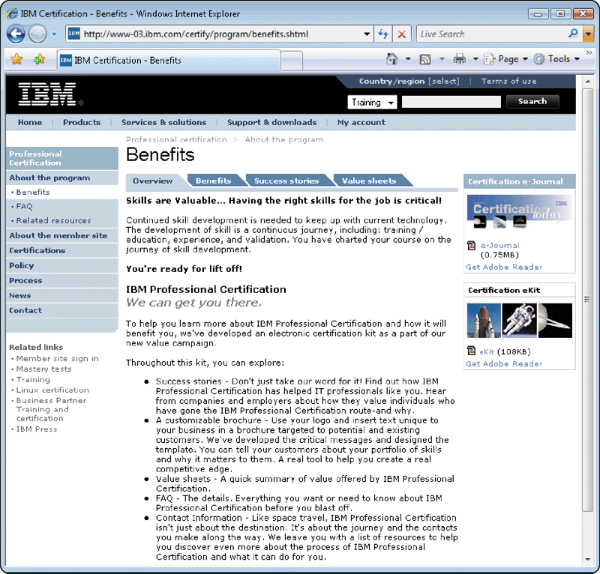
Certification
What are benefits of vendor-sponsored certification?
Vendors provide access to technical information, advanced training, and discounts on publications and tools
p. 793 Fig. 15-17
Next

Slide 27
Certification
How does certification benefit customers, employers, and industry?
Customers receive better service from employees with certification(s)
Employers benefit from more productive and knowledgeable workers
Certification is a form of industry self-regulation
Institute for Certification of Computer Professionals (ICCP) defines standards designed to raise competence level for computer industry
Click to view Web Link, click Chapter 15, Click Web Link from left navigation, then click Institute for the Certification of Computing Professionals below Chapter 15
p. 793
Next

Slide 28
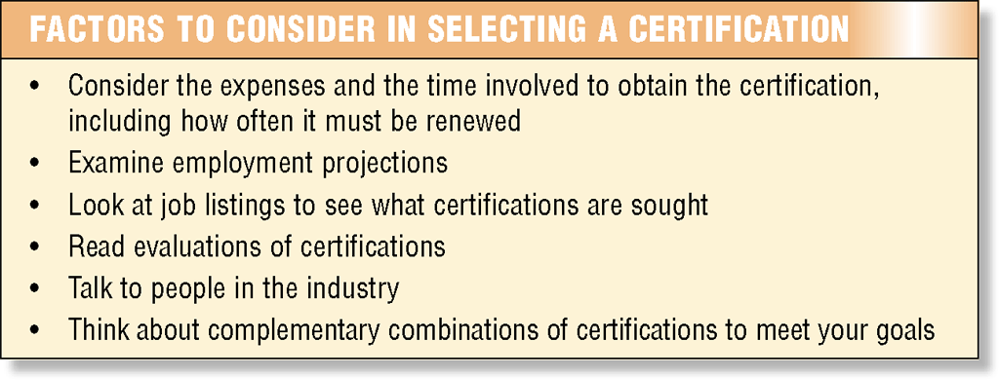
Certification
What are factors to consider in choosing a certification?
p. 794 Fig. 15-18
Next

Slide 29
Certification
What options are available to prepare for certification?
Self-study
Online training classes
Instructor-led training
Web resources
Click to view Web Link, click Chapter 15, Click Web Link from left navigation, then click Online Training Classes below Chapter 15
p. 794
Next

Slide 30
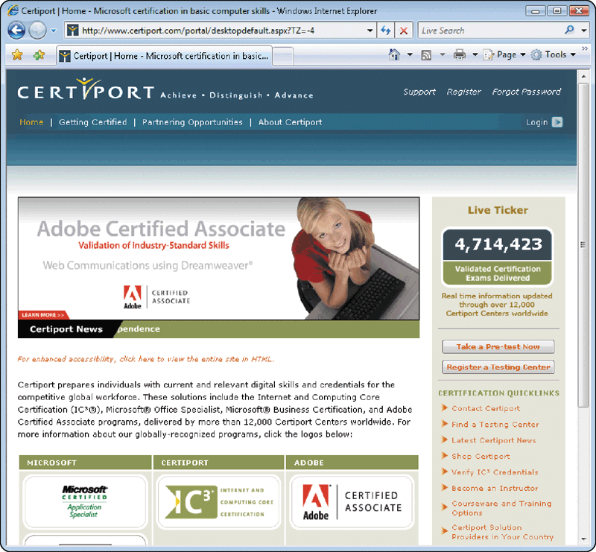
Certification
What are examinations like?
Taken using computers
Some are multiple choice, others are skill based
With computerized adaptive testing, the tests analyze a person’s responses while taking the test
p. 795 Fig. 15-19
Next

Slide 31
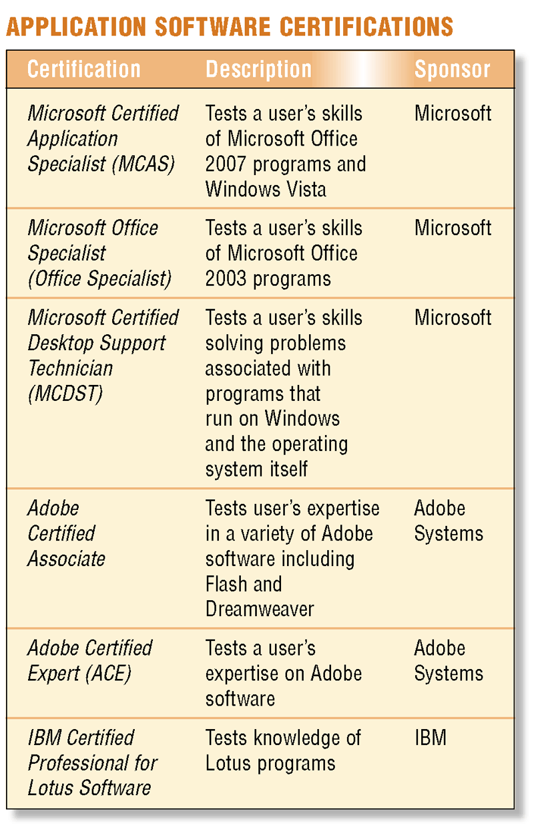
A Guide to Certification
What are application software certifications?
Focus on knowledge of application software
Sometimes called end-user certifications
Click to view Web Link, click Chapter 15, Click Web Link from left navigation, then click Microsoft Certified Application Specialist below Chapter 15
p. 796 Fig. 15-20
Next

Slide 32
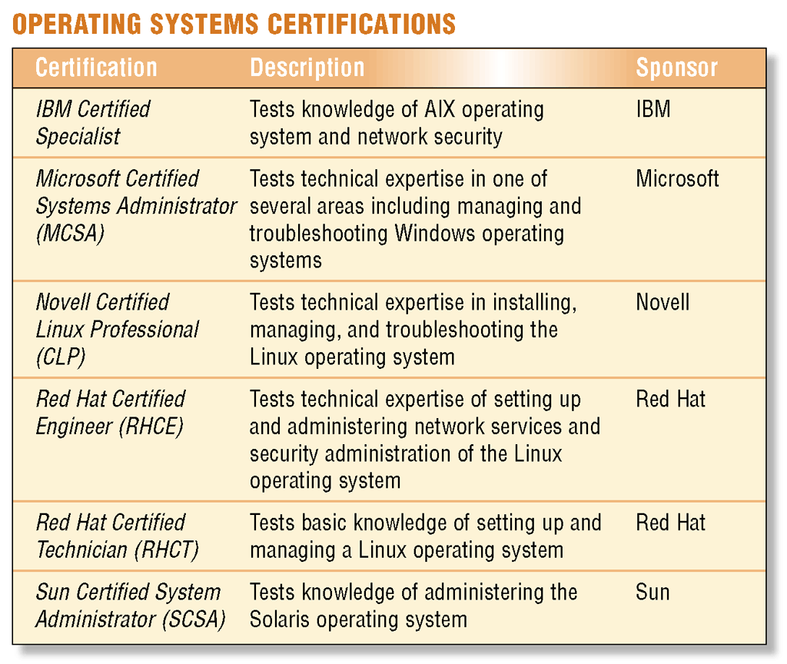
A Guide to Certification
What are operating system certifications?
Focus on particular skills—user, operator, system administrator, and system engineer
Differing levels of certification
p. 797 Fig. 15-21
Next

Slide 33
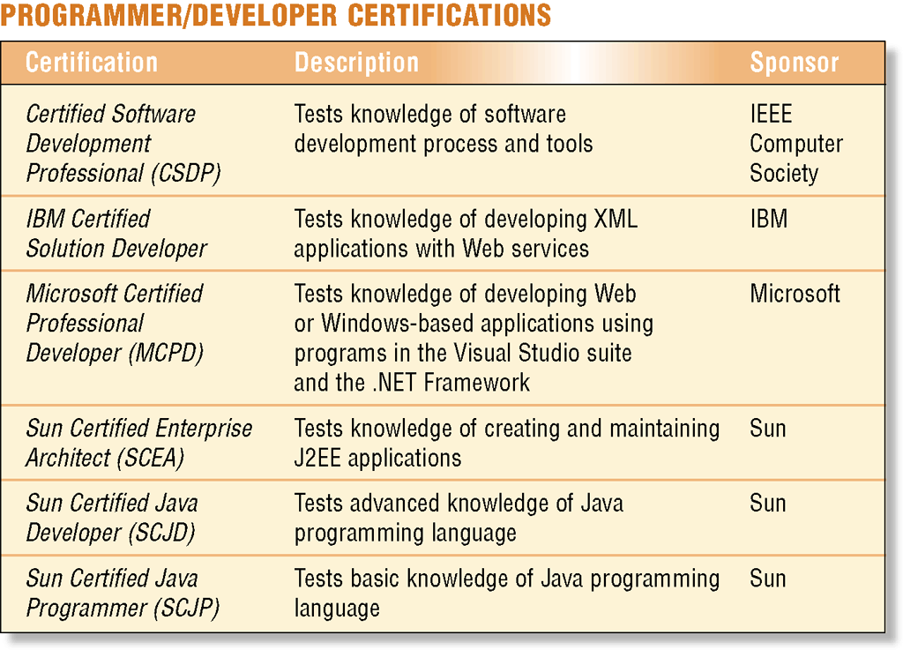
A Guide to Certification
What are programmer/developer certifications?
Recognition of programming training
Broadens knowledge and skill base
p. 797 Fig. 15-22
Next

Slide 34
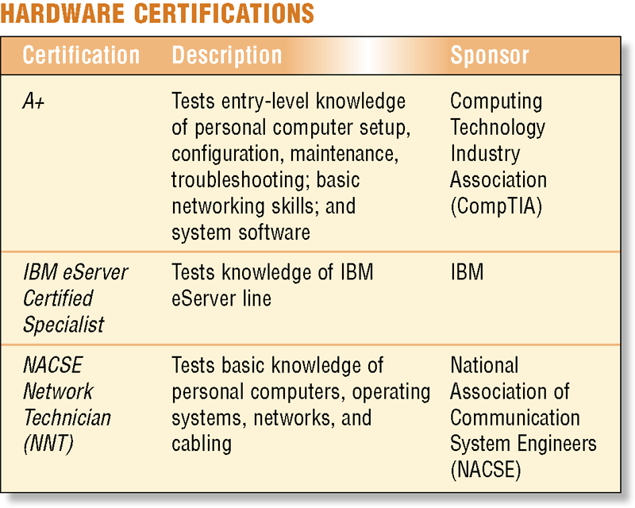
A Guide to Certification
What are hardware certifications?
Recognition of general knowledge of hardware and controlling software needed to set up, maintain, and repair a computer
Can be narrowly or broadly focused
Click to view Web Link, click Chapter 15, Click Web Link from left navigation, then click A+ Certification below Chapter 15
p. 798 Fig. 15-23
Next

Slide 35
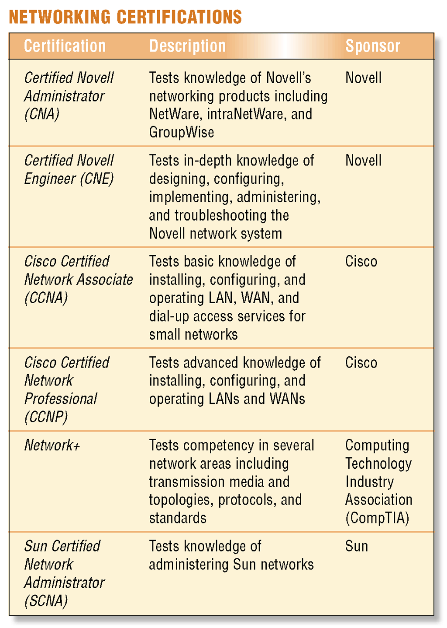
A Guide to Certification
What are networking certifications?
Awarded to professionals who demonstrate expertise in planning, installing, managing, and troubleshooting a network
p. 798 Fig. 15-24
Next

Slide 36
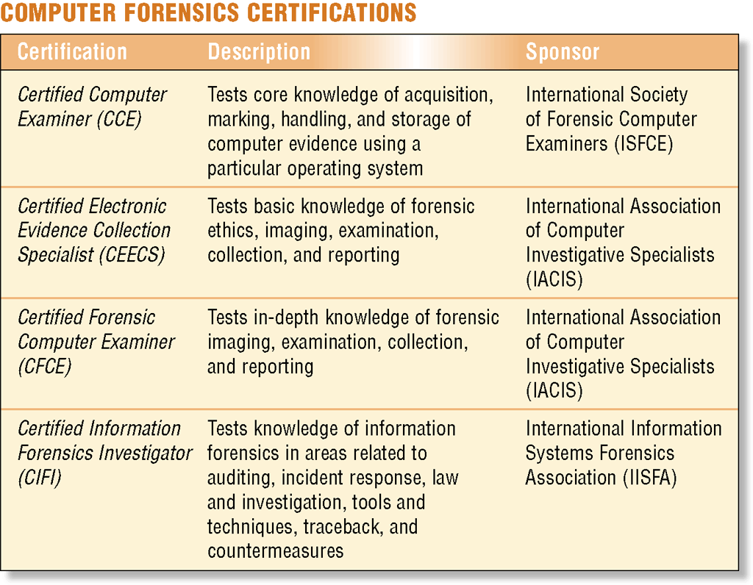
A Guide to Certification
What are computer forensics certifications?
Discovery, collection, and analysis of evidence found on computers and networks
Certificate holders are considered highly credible during computer crimes cases
p. 799 Fig. 15-25
Next

Slide 37
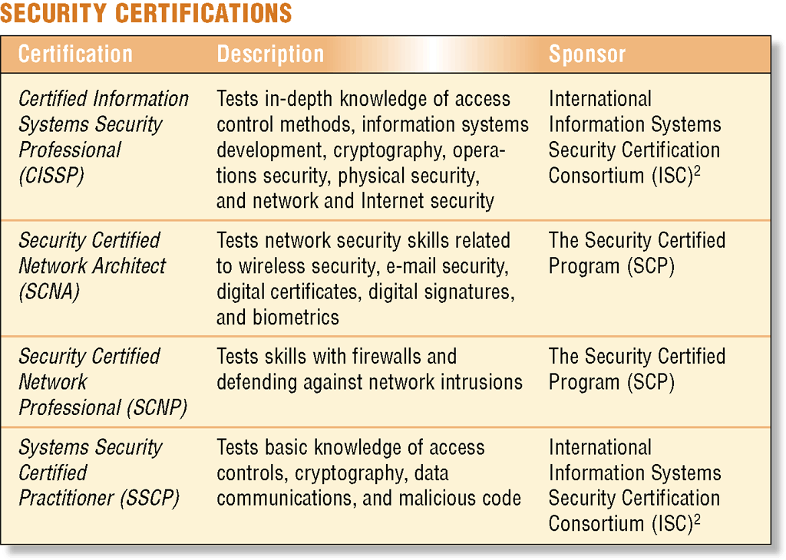
A Guide to Certification
What are security certifications?
Measure a candidate’s ability to identify and control security risks to computer resources
p. 799 Fig. 15-26
Next

Slide 38
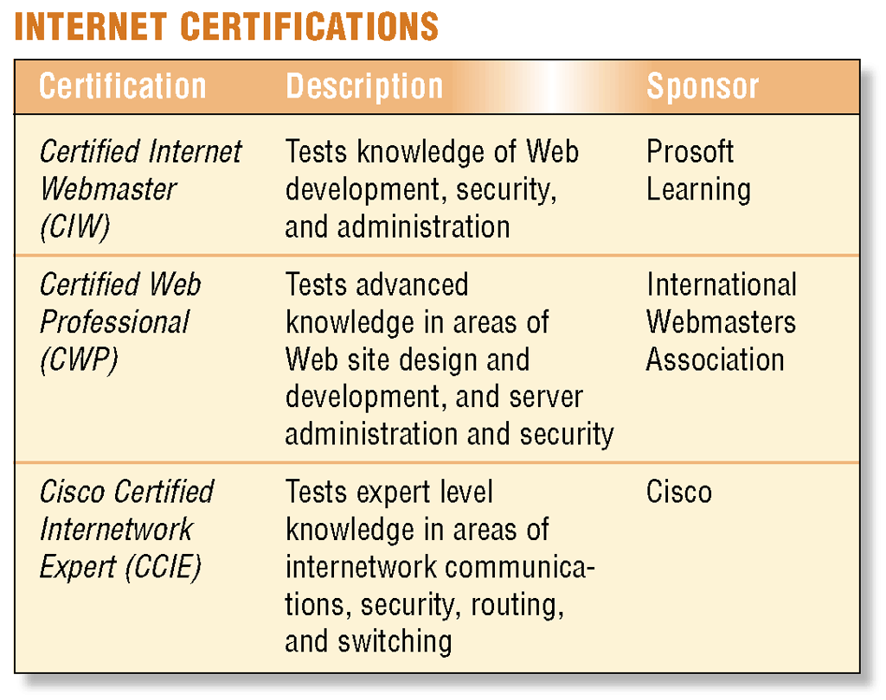
A Guide to Certification
What are Internet certifications?
Require technical expertise in networking hardware and configuration
Include Web management, Web programming, and Web development certifications
Click to view Web Link, click Chapter 15, Click Web Link from left navigation, then click Certified Internet Webmaster below Chapter 15
p. 800 Fig. 15-27
Next

Slide 39
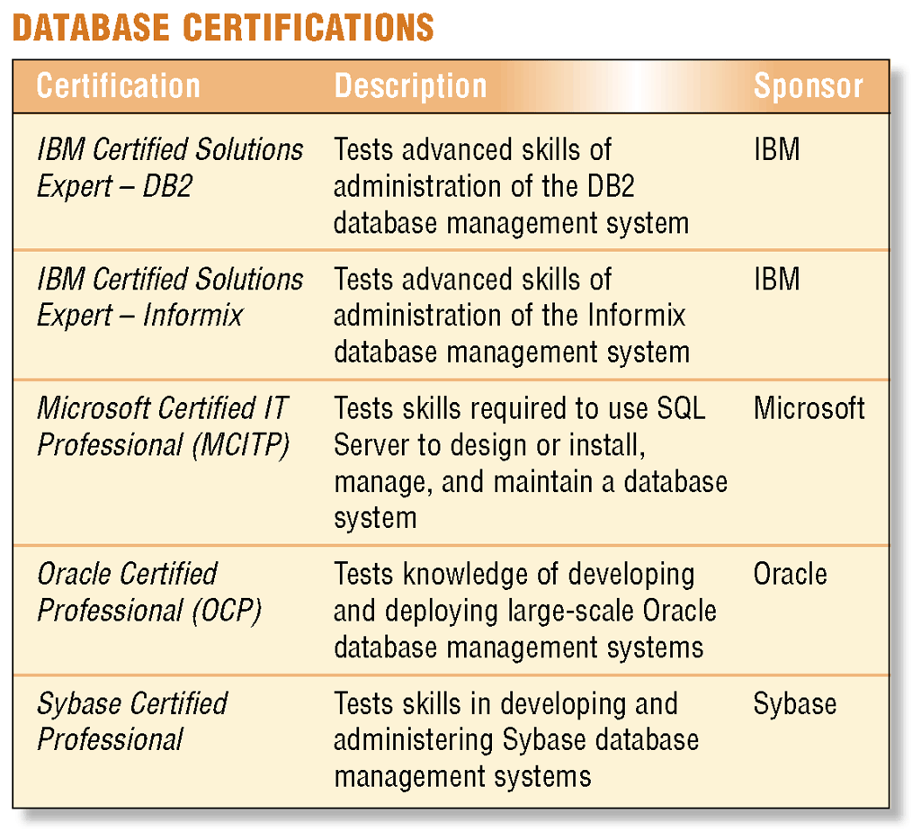
A Guide to Certification
What are database system certifications?
Awarded for knowledge of a specific database management system
Test the various tasks a database management staff must perform
p. 800 Fig. 15-28
Next

Slide 40

High-Tech Talk
Video: Fly Planes n a 360-Degree Virtual Universe
CLICK TO START
Next

Slide 41
Summary of Computer Careers and Certification
Variety of available computer-related careers
Certification preparation, examinations, and resources
Computer education at trade schools, computer-related majors at colleges and universities, job searches, career development planning, professional organizations, and professional growth
Specific certifications
Chapter 15 Complete

